Slide 1

Introduction to Text Mining
STAT 474 – Techniques for Large Data Set
Notes:
Are your classroom colors different than what you see in this template? That’s OK! Click on Design -> Variants (the down arrow) -> Pick the color scheme that works for you!
Feel free to change any “You will…” and “I will…” statements to ensure they align with your classroom procedures and rules!

Slide 2
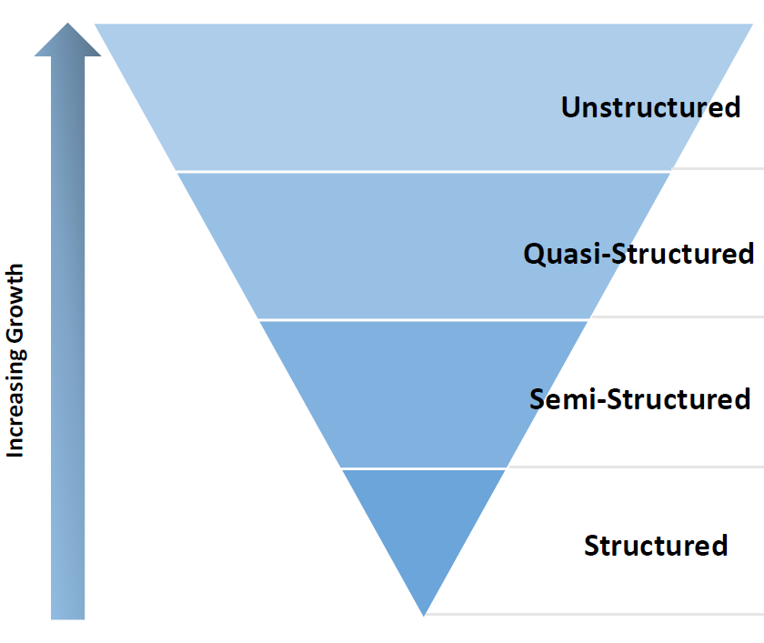
Why should we work with text?
Text data is everywhere. About 80% of world's data is in "unstructured text format"
Need methods to extract, summarize, and analyze useful information from unstructured/text data
Text mining seeks to automatically discover useful knowledge from the massive amount of data
Notes:
Unstructured ; video, unwork
Structued : worked , nice one

Slide 3
Case study for text mining Application in Biotech industry
80% of biological knowledge is only in research paper (unstructured data)
If a scientist manually read 50 research paper/week and only 10% of those data are useful then he/she manages only 5 research paper/week.
Online databases like Medline adds more than 10,000 abstracts per month using text mining:
The performance of gathering relevant data is increased dramatically when we use text mining

Slide 4
What is Text Mining?
Big picture definition: Text mining is the process of distilling actionable insights from text.
Working definition:
Use of computational techniques to extract high quality (quantified) information from text.
Extract and discover knowledge hidden in the text automatically.
SIGKDD’s definition: “Discovery by computer of new previously unknown information, by automatically extracting information from a usually large amount of different unstructured textual resources."

Slide 5
Why text mining is challenging?
Word Ambiguity:
Automobile = car = vehicle = Toyota
Apple (the company) or apple (fruit)
Context sensitivity:
"AOL merges with Time-Warner" versus "Time Warner is brought by AOL"
"This camera sucks." versus "This vacuum cleaner really sucks."
Noisy data
Spelling mistakes

Slide 6
A Basic Workflow of a Text Mining Project
Define the problem and specific goal
Identify the text that needs to be collected
Organize the text
Extract features
Analyze
Reach an insight or recommendation.

Slide 7
A simple Example
Suppose you are a Nike employee and you want to know about how consumers are viewing the Nike Men’s Roshe Run Shoes.
Define the problem: customer’s view of the product (positive versus negative, consistent poor reviews)
Identify the text: Reviews from Amazon, online stores, etc. form a corpus.
Organize the text: Distribution of product review stars, actual review messages.
Extract features: remove unnecessary words, scan for keywords of interest.
Analyze: association of poor reviews with keywords like “fit”, “narrow”, or “tear”
Reach an insight or recommendation.

Slide 8
Computational Steps in Text Mining
Text Pre-processing (Extracting feature)
Cleaning up: misspelling, lower- vs. upper-cases, punctuation, etc.
Natural language processing: part of speech tagging, Syntactic parsing, etc.
Concept of tidytext, tokenization, normalization, etc.
Feature Generation (Extracting feature)
Bag of words
Word2vec
Analyze: feature selection (dimension reduction), statistical models (regression), machine learning (classification/clustering)

Slide 9
Text Pre-processing
The tidy text format follows the tidy data principle
A table with one token per row
A token is a meaningful unit of text, such as a word that we are interested in using for analysis.
Tokenization = process of splitting text into tokens
Non-tidy text format:
String
Corpus: collections of raw strings annotated with additional metadata and details.
Document-term matrix: describing a collection of documents (one row for each document, one column for each term)

Slide 10
Tokenization and its challenges
Example: “Friends, Romans and Countrymen”
Tokens: “Friends”, “Romans”, “Countrymen”
Should the word “and” be a token?
Example: Finland's capital
Finland AND s? Finlands? Finland's?
Example: Hewlett-Packard is splitted into Hewlett and Packard as two tokens?
typical solution: break up hyphenated sequence
Tough choice: co-education?
lowercase vs lower-case vs lower case?
Example: San Francisco - one token or two?
-

Slide 11
Stop words
Common words which would appear to be of little value. For example: the, a, and, to, be, …
With a stop word list, you exclude all the commonest words from the list of tokens. Intuition:
They have little semantic(meaning) content.
There are a lot of them: about 30% of Twitter postings are top 30 words.
Texts specific domain may have different sets of stop words.
Legal documents have a lot of “defendant”, “plaintiff”, …
Twitter postings have many “LOL”, “BTW”, “OMG”, etc.

Slide 12
Remove or not remove stop words
Benefit of removing: saving storage and improve performance
Arguments against removing stop words:
Presence of good compression techniques means the space for including stop words in a system is very small.
Good query optimization techniques mean you pay little at query time for including stop words.
Many cases require stop words:
Phrase queries: "King of Denmark"
Various song titles, etc.: "Let it be", "To be or not to be"

Slide 13
Normalization
We may need to "normalize" words in the text as well as tokens (words) into the same form
We want to match U.S.A. and USA
Abbreviation: approx. -> approximate, lib. -> library
Internet acronyms: diy -> “Do it yourself”, FYI -> “For your information”, etc.
Text messaging shortcut: 2moro -> “tomorrow”, 2nite -> “tonight”, “CUL8R” -> “see you later”
Implicitly define equivalence classes of terms:
deleting periods to form a term, e.g., U.S.A.-> USA
deleting hyphens to form a term, e.g., anti-discriminatory -> antidiscriminatory

Slide 14
Other pre-processing types
Case folding: reduce all letters to lower case
Exception: uppercase in the mid-sentence
Example: General Motors, Fed vs fed
Very hard to deal with exception -> lowercase everything
Longstanding Google example: search for “C.A.T” will return pages about “cats”, not Caterpillar Inc.
Lemmatization: reduce inflectional/variant forms to base forms
am, are, is -> be
Car, cars, car’s, cars’ -> car
Stemming: reduce words to their “roots”
Automate(s), automatic, automation -> automat

Slide 15
Natural Language Processing
Part of speech tagging (text enrichment)

Slide 16
Do we need to do all of them?
Must Do:
Noise removal: digits, numbers, punctuations, and special characters or emoticons.
Case folding (few scenarios where it’s not required)
Should Do:
Simple normalization, e.g., standardize near identical words
Task Dependent:
Advanced normalization (e.g., out-of-vocabulary words)
Stop word removal
Stemming or lemmatization
Natural Language Processing, text enrichment

Slide 17
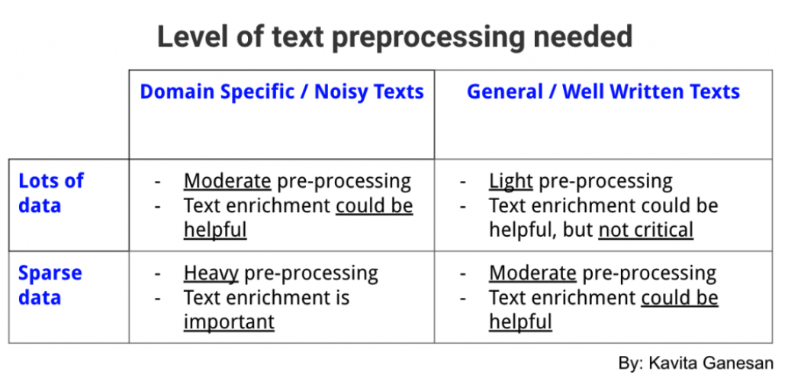
Rule of Thumbs

Slide 18
Demo Simple Text Analysis
Word frequencies with classic novels

